Slide 1



Proposal for Workflow System
By
ACE Data Systems Ltd V 1.0

Slide 2
System Functionality
Cloud-based solution
provide anytime/anywhere access to the information
no hardware maintenance
Can access system from any PC and App(Android and IOS)
Paperless
track each case history, bottleneck of the process and improve the process
data confirmation and approval
reduce the use of paper document
Security
User and Roles based access
Integration
email notification
Reliability
search, re-assign, view history, route of any case

Slide 3
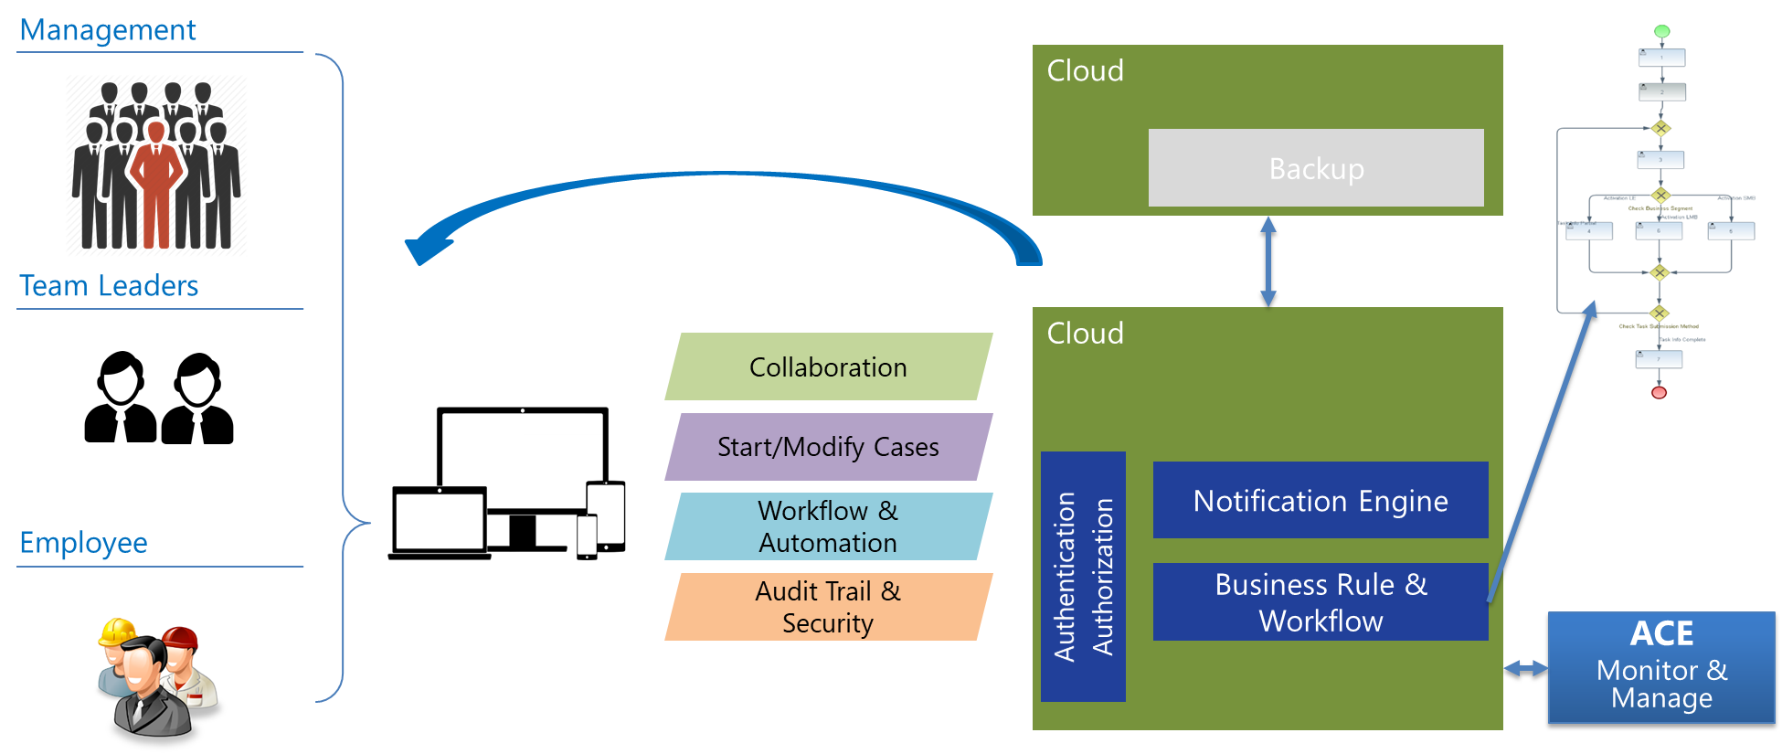
Overall Architecture

Slide 4

Applied Technologies

Slide 5
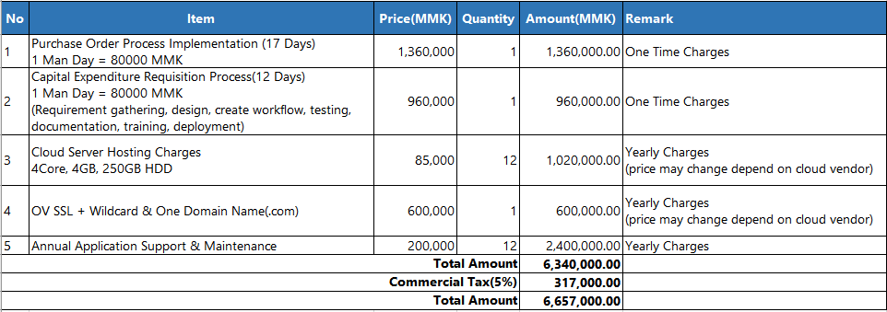
Budgetary Quotation

Slide 6
Annual Support & Maintenance Scope
Support Hour : 9:00 AM to 5:00 PM (Monday to Friday)
Support Channel : Email or Phone
Support Scope : System usage support, Bug fix in existing process, minor UI changes

Slide 7
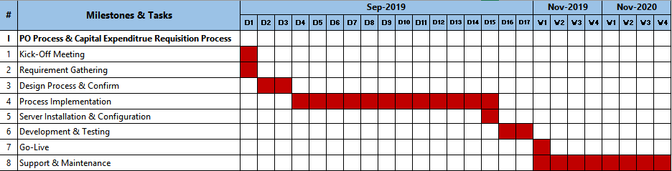
Delivery Timeline

Slide 8
THANK YOU

